Slide 1
THE PREWRATH RAPTURE?
Pre-Trib Study Group 2023
Andrew Marshall Woods, Th.M., JD., PhD.
Sr. Pastor, Sugar Land Bible Church

Slide 2
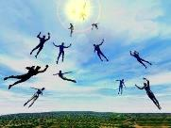
When Will the Rapture Take Place Relative to the Tribulation Period?
Pre-tribulation rapture theory
Mid-tribulation rapture theory
Post-tribulation rapture theory
Pre-wrath rapture theory
Partial rapture theory

Slide 4
Pre-Wrath Rapturism
Description of the view
Problems with the view considering prior Pre-Tribulational Arguments
Additional problems with the view

Slide 5
Pre-Wrath Rapturism
Description of the view
Problems with the view considering prior Pre-Tribulational Arguments
Additional problems with the view

Slide 6
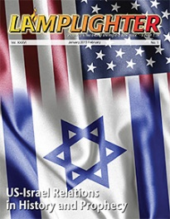
Dr. David Reagan
“I have a number of objections to this concept of the Rapture's timing. 1) The Name — I object to the name given the viewpoint by its proponents. The name is both confusing and vague. It is confusing because both the Pre-Trib and Mid-Trib views are ‘Pre- Wrath.’ The Pre-Trib view argues that the entire 7 years of the Tribulation (Daniel's 70th Week of Years) constitutes a pouring out of the wrath of God. The Mid-Trib view takes the position that only the second half of the Tribulation is the period of God's wrath. So, Rosenthal's name for his viewpoint does not distinguish it from the Pre-Trib and Mid-Trib views. All three are prewrath views. The .‘Pre-Wrath’ name is also vague because it does not give a clue as to when the Rapture occurs in relation to the Tribulation. The name of the Pre-Trib view signifies a belief that the Rapture will occur before (pre) the Tribulation begins. The name of the . . .
“The Pre-wrath Rapture,” online: https://christinprophecy.org/articles/the-pre-wrath-rapture/, accessed March 20, 2020.

Slide 7
Dr. David Reagan
. . . Mid-Trib view clearly indicates a belief that the Rapture will occur in the middle of the Tribulation. The name of the Post-Trib view puts the Rapture after (post) the Tribulation. But the name, ‘Pre-Wrath’ gives no indication of when the Rapture will occur with relation to the Tribulation. For that reason, I have decided to call the ‘Pre-Wrath’ view the Three-Quarters Tribulation Rapture viewpoint. And I will be abbreviating it throughout the rest of this article as the ‘3/4 Trib Rapture.’ I have given it that name because its proponents believe the Rapture will occur about three-quarters of the way through the Tribulation, or shortly thereafter.”
“The Pre-wrath Rapture,” online: https://christinprophecy.org/articles/the-pre-wrath-rapture/, accessed March 20, 2020.

Slide 8
Dr. David Reagan
“In 1990 Marvin Rosenthal presented a fourth viewpoint in his book, The Pre-Wrath Rapture of the Church. Rosenthal was not the originator of this new viewpoint. Rather, he was the one who popularized it with his book. The person who conceived the "Pre-Wrath" view of the Rapture was a man named Robert Van Kampen (1938-1999). Van Kampen became one of America's richest men through his involvement in investment banking. During his lifetime he accumulated one of the largest private collections of rare and antique Bibles in North America. In the 1970's Van Kampen began developing the "Pre-Wrath" concept of the timing of the Rapture. Once he had completed his work on the concept, he started trying to find a well-known person in the field of Bible prophecy to endorse his new view.”
“The Pre-wrath Rapture,” online: https://christinprophecy.org/articles/the-pre-wrath-rapture/, accessed March 20, 2020.

Slide 9
Dr. David Reagan
“That person finally turned out to be Marvin Rosenthal, who at the time was serving as the director of a very influential ministry called Friends of Israel. Rosenthal tried to convince the board of the ministry to abandon its commitment to the Pre-Trib view and accept the new viewpoint. They refused, and Rosenthal was forced to depart. He went to Florida where he built the Holy Land Experience — a Christian theme park which has since been taken over by the Trinity Broadcasting Network. Today, Rosenthal serves as the director of Zion's Hope, a ministry located in Winter Garden, Florida. Rosenthal's book was financed by Van Kampen's fortune, and he mailed out thousands of copies to pastors all over America. Later, Van Kampen wrote his own books about the ‘Pre-Wrath’ view, the most important being The Sign (1992).”
“The Pre-wrath Rapture,” online: https://christinprophecy.org/articles/the-pre-wrath-rapture/, accessed March 20, 2020.

Slide 10
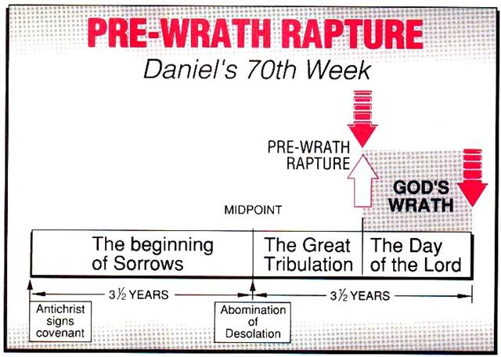
Marvin J. Rosenthal, The Pre-Wrath Rapture of the Church: A New Understanding of the Tribulation, and the Second Coming (Nashville, TN: Thomas Nelson, 1990), 112.

Slide 11
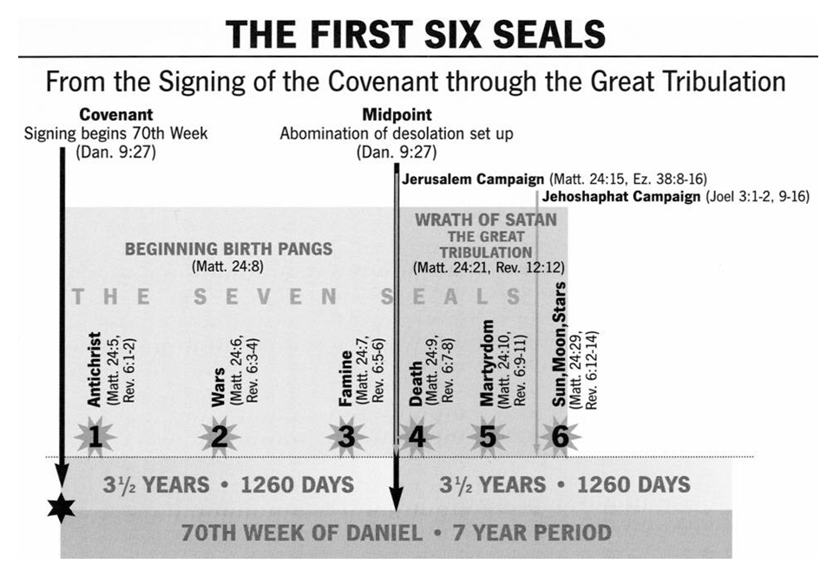

Slide 12
Marvin J. Rosenthal, The Pre-Wrath Rapture of the Church: A New Understanding of the Tribulation, and the Second Coming (Nashville, TN: Thomas Nelson, 1990), 112.

Slide 13
2 Thessalonians 2:6-7
⁶And you know what restrains [katechon; neuter] him now, so that in his time he will be revealed. ⁷For the mystery of lawlessness is already at work; only he who now restrains [katechōn; masculine] will do so until he is taken out of the way.

Slide 14
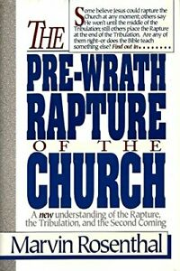
Marvin Rosenthal
“…of paramount importance is the identification of the one who restraints or hinders the Antichrist until ‘he [the restrainer] be taken out of the way.’ The restrainer is neither the Holy Spirit nor human government. Evidence is strained to support either of those contentions. There is, however, substantial evidence to identify the restrainer. He who restraints until ‘he be taken out of the way’ is the Archangel Michael.”
Marvin J. Rosenthal, The Pre-Wrath Rapture of the Church: A New Understanding of the Tribulation, and the Second Coming (Nashville, TN: Thomas Nelson, 1990), 112.

Slide 15
Marvin J. Rosenthal, The Pre-Wrath Rapture of the Church: A New Understanding of the Tribulation, and the Second Coming (Nashville, TN: Thomas Nelson, 1990), 112.

Slide 16
Revelation 6:16-17
^{“16} and they said to the mountains and the rocks, ‘Fall on us and hide us from the sight of Him who sits on the throne, and from the wrath [orgḗ] of the Lamb; ¹⁷ for the great day of Their wrath [orgḗ] has come, and who is able to stand?’”

Slide 17
Pre-Wrath Rapturism
Description of the view
Problems with the view considering prior Pre-Tribulational Arguments
Additional problems with the view

Slide 19
II. Pre-Wrath Rapture Theory Problems
Places the Church in Daniel’s 70th Week
Fails to acknowledge the missing Church (Rev. 4‒22)
Confines God’s wrath to only a portion of the Tribulation's second half
Denies the Rapture’s imminency
Fails to consistently explain how the rapture is a comfort to the believer (John 14:1; 1 Thess. 4:18; Titus 2:13)
Misinterprets the restrainer (2 Thess. 2:6-7) as Michael the Archangel rather than the Holy Spirit

Slide 20
II. Pre-Wrath Rapture Theory Problems
Places the Church in Daniel’s 70th Week
Fails to acknowledge the missing Church (Rev. 4‒22)
Confines God’s wrath to only a portion of the Tribulation's second half
Denies the Rapture’s imminency
Fails to consistently explain how the rapture is a comfort to the believer (John 14:1; 1 Thess. 4:18; Titus 2:13)
Misinterprets the restrainer (2 Thess. 2:6-7) as Michael the Archangel rather than the Holy Spirit

Slide 21
Daniel 9:24
Seventy weeks have been decreed for your people and your holy city, to finish the transgression, to make an end of sin, to make atonement for iniquity, to bring in everlasting righteousness, to seal up vision and prophecy and to anoint the most holy place.

Slide 22
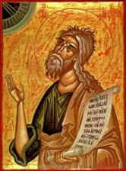
Jeremiah 30:7
“Alas! for that day is great, There is none like it; And it is the time of Jacob’s distress (Gen. 32:8; 35:10), But he will be saved from it.”

Slide 23
Robert Lightner
Last Days Handbook: A Complete Guide to the End Times, Including the Meaning of the Year 2000 in Bible Prophecy, rev. ed. (Nashville: Thomas Nelson, 1997), 95.
“The prewrath Rapture view is different from the normal pretribulational view in that it does not consistently distinguish between God's program with Israel and His program with the church. The way it differs is that it has the church in Israel's seventieth week...”

Slide 24
George Zeller
“. . . The Pre-Wrath view sees the Church as being on earth during a large part of Daniel's 70th week (the Church will be on earth, according to Rosenthal's charts, for approximately 3/4 of the last seven years, or approximately five years or more). This mixes up and confuses God's purpose for Israel and God's purpose for the Church. THE CHURCH HAS NEVER AND WILL NEVER BE PRESENT ON EARTH DURING ANY OF ISRAEL'S 70 WEEKS. The Church began after the 69th week ended and the Church will be raptured before the 70th week begins.... ”
"Pre-Wrath Confusion," online: http://www.middletownbiblechurch.org/proph/prewrath.htm, accessed 01 September 2015.

Slide 25
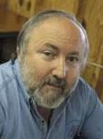
Arnold G. Fruchtenbaum “Israel and the Church,” in Issues in Dispensationalism, ed. Wesley R. Willis and John R. Master (Chicago: Moody, 1994), 118.
“In the book of Acts, both Israel and the church exist simultaneously. The term Israel is used twenty times and ekklēsia (church) nineteen times, yet the two groups are always kept distinct.”

Slide 26
Matthew 16:18
“I also say to you that you are Peter, and upon this rock I WILL build [oikodomeō] My church; and the gates of Hades WILL NOT overpower it.”

Slide 27
II. Pre-Wrath Rapture Theory Problems
Places the Church in Daniel’s 70th Week
Fails to acknowledge the missing Church (Rev. 4‒22)
Confines God’s wrath to only a portion of the Tribulation's second half
Denies the Rapture’s imminency
Fails to consistently explain how the rapture is a comfort to the believer (John 14:1; 1 Thess. 4:18; Titus 2:13)
Misinterprets the restrainer (2 Thess. 2:6-7) as Michael the Archangel rather than the Holy Spirit

Slide 28
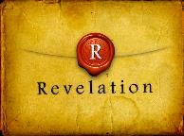
Revelation 1:19
“Therefore write the things which you have seen, and the things which are, and the things which will take place after these things [meta tauta].”

Slide 29
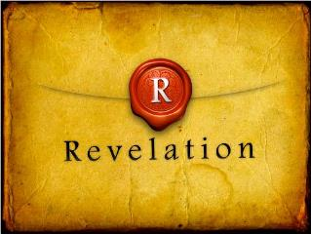
Revelation 1:19
Seen (1)
Are (2–3)
After these things (4–22)

Slide 30
Ephesians 2:14
For He Himself is our peace, who made both groups into one and broke down the barrier of the dividing wall.

Slide 31
God’s Work Through Israel
Revelation 7 – 144,000 Jews
Revelation 11 – Two Jewish witnesses
Revelation 12 – Israel flees

Slide 32
Psalm 50:5 (NKJV)
“Gather My saints together to Me, Those who have made a covenant with Me by sacrifice.”

Slide 33
Psalm 149:1 (NKJV)
“Praise the Lord! Sing to the Lord a new song, And His praise in the assembly of saints.”

Slide 34
Matthew 16:18
“I also say to you that you are Peter, and upon this rock I WILL build [oikodomeō] My church; and the gates of Hades WILL NOT overpower it.”

Slide 35
II. Pre-Wrath Rapture Theory Problems
Places the Church in Daniel’s 70th Week
Fails to acknowledge the missing Church (Rev. 4‒22)
Confines God’s wrath to only a portion of the Tribulation's second half
Denies the Rapture’s imminency
Fails to consistently explain how the rapture is a comfort to the believer (John 14:1; 1 Thess. 4:18; Titus 2:13)
Misinterprets the restrainer (2 Thess. 2:6-7) as Michael the Archangel rather than the Holy Spirit

Slide 36
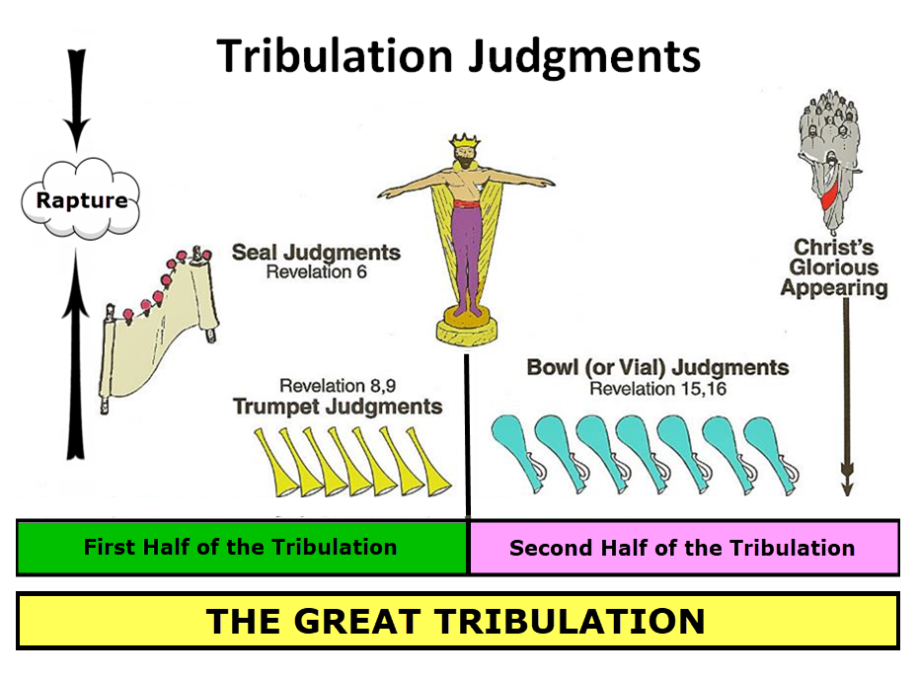

Slide 37
Marvin J. Rosenthal, The Pre-Wrath Rapture of the Church: A New Understanding of the Tribulation, and the Second Coming (Nashville, TN: Thomas Nelson, 1990), 112.

Slide 38
Zephaniah 1:14-15
¹⁴ The great day of the Lord is near, Near and coming very quickly; Listen, the day of the Lord! In it the warrior cries out bitterly. ¹⁵ That day is a day of anger, A day of trouble and distress, A day of destruction and desolation, A day of darkness and gloom, A day of clouds and thick darkness.

Slide 39
Zephaniah 1:14-15
¹⁴ The great day of the Lord is near, Near and coming very quickly; Listen, the day of the Lord! In it the warrior cries out bitterly. ¹⁵ That day is a day of anger, A day of trouble and distress, A day of destruction and desolation, A day of darkness and gloom, A day of clouds and thick darkness.

Slide 40
Zephaniah 1:14-15
¹⁴ The great day of the Lord is near, Near and coming very quickly; Listen, the day of the Lord! In it the warrior cries out bitterly. ¹⁵ That day is a day of anger, A day of trouble and distress, A day of destruction and desolation, A day of darkness and gloom, A day of clouds and thick darkness.

Slide 41
Zephaniah 1:14-15
¹⁴ The great day of the Lord is near, Near and coming very quickly; Listen, the day of the Lord! In it the warrior cries out bitterly. ¹⁵ That day is a day of anger, A day of trouble and distress, A day of destruction and desolation, A day of darkness and gloom, A day of clouds and thick darkness.

Slide 42
Revelation 6:16-17
^{“16} and they said to the mountains and the rocks, ‘Fall on us and hide us from the sight of Him who sits on the throne, and from the wrath [orgḗ] of the Lamb; ¹⁷ for the great day of Their wrath [orgḗ] has come and who is able to stand?’”

Slide 43
Marvin Rosenthal
“In Revelation 6:17 again the equivalent phrase ‘for the great day of his wrath is come [aorist]’ can be demonstrated to have but one meaning: God’s day of the Lord’s wrath is impending. It is about to happen; it has not yet occurred. There is no legitimate way that the phrase ‘the great day of his wrath is come’ in the context of Revelation 6:17 can be made retroactive to include the first six seals…Contextually, therefore, once again God‘s wrath cannot be understood to include the first six seals.”
Marvin J. Rosenthal, The Pre-Wrath Rapture of the Church: A New Understanding of the Tribulation, and the Second Coming (Nashville, TN: Thomas Nelson, 1990), 166, 71.

Slide 44
Rev. 6:16-17 Robert L. Thomas, Revelation 1–7: An Exegetical Commentary, ed. Kenneth Barker (Chicago: Moody, 1992), 457-58.
"Mankind in his rebellion correctly analyzes the cosmic and terrestrial disturbances as a part of the great end-time day of wrath from the one sitting on the throne and from the Lamb. The verb ēlethen (‘has come’) is aorist indicative, referring to a previous arrival of wrath, not something that is about to take place. Men see the arrival of this day at least as early as the cosmic upheavals that characterize the sixth seal (6:12-14), but upon reflection they probably recognize that it was already in effect with the death of one-fourth of the population (6:7-8), the worldwide famine (6:5-6), and the global warfare (6:3-4). The rapid sequence of all of these events could not escape notice, but the light of their true explanation does not dawn upon human consciousness until the severe phenomena of the sixth seal arrive."

Slide 45
Gerald B. Stanton
“...Rosenthal. For he constantly asserts that the outpoured wrath of God does not commence until Revelation 8:1, the seventh seal, which immediately introduces the unprecedented judgments of the seven trumpets…Even the most casual reading of Revelation 6:12-17 reveals that the cry of verses 6-17 is a scream of terror from the wicked, rebellious human leaders who have endured war and famine, death and destruction, a shattering earthquake, and a frightful disruption of heavenly bodies under the earlier judgments. Obviously, they are responding to past judgment and not judgments yet to come, for wicked men have no ability to speak a prophecy! It is true that the aorist tense normally has no time significance.”
Gerald B. Stanton, Kept From the Hour: Biblical Evidence for the Pretribulational Return of Christ (Grand Rapids: Zondervan, 1956; reprint, Miami Springs, FL: Schoettle, 1991), 387-88.

Slide 46
Gerald B. Stanton
“But the verb ēlethen is in the aorist tense and indicative mood, and when this occurs it refers to a past action and not to a future [H. E. Dana and Julius R. Mantey, A Manual Grammar of the Greek New Testament (New York: Macmillan, 1950), 178]. Hence, the proper translation is ‘the great day of his wrath is come,’ or as the vast majority of translators put it, the great day of his wrath has come.’ It is a major error to force the translation to declare, ‘the great day of his wrath will come.’ One can only conclude that this strong reference to the wrath of God is the direct response of the wicked to their shattering experience under the first six seals, and not a veiled prophecy of coming trumpet judgments.”
Gerald B. Stanton, Kept From the Hour: Biblical Evidence for the Pretribulational Return of Christ (Grand Rapids: Zondervan, 1956; reprint, Miami Springs, FL: Schoettle, 1991), 388.

Slide 47
Norman Geisler
Systematic Theology, vol. 4 (Minneapolis, MN: Bethany, 2004), 652.
“Absence of a word does not prove absence of the concept. For example, the word wrath does not appear in Genesis, yet God's wrath was poured out during the flood (6–8) and on Sodom and Gomorrah (19).”

Slide 48
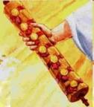
1st Six Seals (Revelation 6)
SEAL 1 – 6:1-2 – Advent of antichrist
SEAL 2 – 6:3-4 – War
SEAL 3 – 6:5-6 – Famine
SEAL 4 – 6:7-8 – Death
SEAL 5 – 6:9-11 – Martyrdoms
SEAL 6 – 6:12-17 – Cosmic disturbances

Slide 49
Revelation 7:14
“I said to him, “My lord, you know.” And he said to me, “These are the ones who come out of the great tribulation [thlípsis], and they have washed their robes and made them white in the blood of the Lamb.”

Slide 50
John 16:33
“These things I have spoken to you so that in Me you may have peace. In the world you have tribulation [thlípsis], but take courage; I have overcome the world.”

Slide 51
Marvin J. Rosenthal, The Pre-Wrath Rapture of the Church: A New Understanding of the Tribulation, and the Second Coming (Nashville, TN: Thomas Nelson, 1990), 112.

Slide 52
Romans 2:8-9
^{“8} but to those who are selfishly ambitious and do not obey the truth, but obey unrighteousness, wrath [orgḗ] and indignation [thumós]. ⁹ There will be tribulation [thlípsis] and distress for every soul of man who does evil, of the Jew first and also of the Greek.”

Slide 53
1st Six Seals (Revelation 6)
SEAL 1 – 6:1-2 – Advent of antichrist
SEAL 2 – 6:3-4 – War
SEAL 3 – 6:5-6 – Famine
SEAL 4 – 6:7-8 – Death
SEAL 5 – 6:9-11 – Martyrdoms
SEAL 6 – 6:12-17 – Cosmic disturbances

Slide 54
Isaiah 9:11-12
^{“11} Therefore the Lord raises superior adversaries against them from Rezin And provokes their enemies, ¹² The Arameans from the east and the Philistines from the west; And they devour Israel with gaping jaws. In spite of all this, His anger does not turn away, And His hand is still stretched out.”

Slide 55
Isaiah 10:5-6
^{“5} Woe to Assyria, the rod of My anger And the staff in whose hands is My indignation, ⁶ I send it against a godless nation And commission it against the people of My fury To capture spoils and to seize plunder, And to trample them down like mud in the streets.”

Slide 56
Isaiah 13:3, 17
“³ I have commanded My consecrated ones, I have also called for My warriors Who boast in My eminence, To execute My anger…¹⁷ Behold, I am going to stir up the Medes against them, Who will not value silver or take pleasure in gold.”

Slide 57
2 Samuel 24:1
“Now the anger of the Lord burned against Israel again, and He incited David against them to say, ‘Go, count Israel and Judah.’”

Slide 58
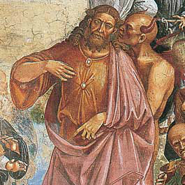
1 Chronicles 21:1
“Then Satan stood up against Israel and incited David to count Israel.”

Slide 59
Romans 13:4
“for it is a servant of God to you for good. But if you do what is evil, be afraid; for it does not bear the sword for nothing; for it is a servant of God, an avenger who brings wrath [orgē] on the one who practices evil.”

Slide 60
2 Thessalonians 2:9-12
^{“9} that is, the one whose coming is in accord with the activity of Satan, with all power and false signs and wonders, ¹⁰ and with all the deception of wickedness for those who perish, because they did not accept the love of the truth so as to be saved. ¹¹ For this reason God will send upon them a deluding influence so that they will believe what is false, ¹² in order that they all may be judged who did not believe the truth, but took pleasure in wickedness.”

Slide 61
PRE-WRATH RAPTURIST – ALAN KURSCHNER
MATTHEW 24 | PARALLELS | REVELATION 6-7
4-5 | The Antichrist / False Christs | 1st Seal (6:1-2)
6-7 | Wars | 2nd Seal (6:3-4)
7 | Famine | 3rd Seal (6:5-6)
9, 21-22 | Martyrdom / (Great Tribulation) | 4th Seal (6:7-8)
9, 21-22 | Result of Martyrdom / (Great Tribulation) | 5th Seal (6:9-11)
29 | Celestial Disturbances | 6th Seal (6:12-17)
30-31 | Raptured Saints | Interlude (7:9-17)
14, 30, 37-40 | Day of the Lord’s Wrath | 7th Seal (Trumpet, Bowls)
Alan Kurschner, The Antichrist Before the Day of the Lord: What Every Christian Needs to Know About the Return of Christ (Pompton Lakes, NI: Eschatos, 2013, 99.

Slide 62
Matthew 24:7
“For nation will rise against nation, and kingdom against kingdom, and there will be famines and earthquakes in various places.”

Slide 63
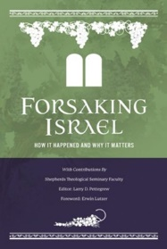
Earthquakes?
“This means that the earthquakes described in Matthew 24:7 (which Rosenthal thinks will occur in the first half of the seven-year era) are the result of the power of Satan or man. Toussaint observes, ‘Interestingly, Rosenthal never explains how the earthquakes in Matthew 24:7 are triggered by humans!’ (Toussaint, “Are the Church and the Rapture in Matthew 24?” The Return, Thomas Ice and Timothy J. Demy, eds. [Grand Rapids: Kregel, 1999], 133).’”
Larry D. Pettegrew, "The Messiah's Lecture on the Future of Israel," in Forsaking Israel: How It Happened and Why It Matters, ed. Larry D. Petegrew (The Woodlands, TX: Kress Biblical Resources, 2020), 364 n. 24.

Slide 64
1st Six Seals (Revelation 6)
SEAL 1 – 6:1-2 – Advent of antichrist
SEAL 2 – 6:3-4 – War
SEAL 3 – 6:5-6 – Famine
SEAL 4 – 6:7-8 – Death
SEAL 5 – 6:9-11 – Martyrdoms
SEAL 6 – 6:12-17 – Cosmic disturbances

Slide 65
Job 19:29
“Then be afraid of the sword for yourselves, For wrath brings the punishment of the sword, So that you may know there is judgment.”

Slide 66
2 Chronicles 36:16-17
^{“16} but they continually mocked the messengers of God, despised His words, and scoffed at His prophets, until the wrath of the Lord rose against His people, until there was no remedy. ¹⁷ So He brought up against them the king of the Chaldeans, who killed their young men with the sword in the house of their sanctuary, and had no compassion on young man or virgin, old man or frail; He handed them all over to him.”

Slide 67
Isaiah 51:19-20
^{“19} These two things have happened to you; Who will mourn for you? The devastation and destruction, famine and sword; How shall I comfort you? ²⁰ Your sons have fainted, They lie helpless at the head of every street, Like an antelope in a net, Full of the wrath of the Lord, The rebuke of your God.”

Slide 68
Jeremiah 21:5-7, 9
^{“5} And I Myself will make war against you with an outstretched hand and a mighty arm, and in anger, wrath, and great indignation. ⁶ I will also strike the inhabitants of this city, both the people and the animals; they will die of a great plague. ⁷ Then afterward,” declares the Lord, “I will hand Zedekiah king of Judah, his servants, and the people, that is, those who survive in this city from the plague, the sword, and the famine, over to Nebuchadnezzar king of. . .

Slide 69
Jeremiah 21:5-7, 9
…Babylon, to their enemies, and to those who seek their lives; and he will strike and kill them with the edge of the sword. He will not spare them nor have pity nor compassion.”’… ⁹ Anyone who stays in this city will die by the sword, by famine, or by plague; but anyone who leaves and goes over to the Chaldeans who are besieging you will live, and he will have his own life as plunder.”

Slide 70
Jeremiah 44:8, 11-12
^{“8} provoking Me to anger with the works of your hands, burning sacrifices to other gods in the land of Egypt where you are entering to reside, so that you may be eliminated and become a curse and a disgrace among all the nations of the earth?... ¹¹ “Therefore thus says the LORD of hosts, the God of Israel, ‘Behold, I am going to set My face against you for woe, even to cut off all Judah. ¹² And I will take away the remnant of Judah who have set their. . .

Slide 71
Jeremiah 44:8, 11-12
... minds on entering the land of Egypt to reside there, and they will all meet their end in the land of Egypt; they will fall by the sword or meet their end by famine. From the small to the great, they will die by the sword and famine; and they will become a curse, an object of horror, an imprecation, and a disgrace.”

Slide 72
Jeremiah 50:13, 25
^{“13} Because of the wrath of the Lord she will not be inhabited, But she will be completely desolate; Everyone who passes by Babylon will be horrified And will hiss because of all her wounds…²⁵ The Lord has opened His armory And has brought out the weapons of His indignation, For it is a work of the Lord God of armies In the land of the Chaldeans.”

Slide 73
Ezekiel 7:14-15
¹⁴‘They have blown the trumpet and made everything ready, but no one is going to the battle, for My wrath is against all their multitude. ¹⁵ The sword is outside the city and the plague and the famine are within. Anyone who is in the field will die by the sword, while famine and the plague will consume those in the city.

Slide 74
1st Six Seals (Revelation 6)
SEAL 1 – 6:1-2 – Advent of antichrist
SEAL 2 – 6:3-4 – War
SEAL 3 – 6:5-6 – Famine
SEAL 4 – 6:7-8 – Death
SEAL 5 – 6:9-11 – Martyrdoms
SEAL 6 – 6:12-17 – Cosmic disturbances

Slide 75
Revelation 6:8
^{“8} I looked, and behold, an ashen horse; and the one who sat on it had the name Death, and Hades was following with him. Authority was given to them over a fourth of the earth, to kill with sword, and famine, and plague, and by the wild animals of the earth.”

Slide 76
Ezekiel 5:15-17
“¹⁵ ‘So it shall be a reproach, a taunt, a lesson, and an astonishment to the nations that are all around you, when I execute judgments among you in anger and in fury and in furious rebukes. I, the Lord, have spoken. ¹⁶ When I send against them the terrible arrows of famine which shall be for destruction, which I will send to destroy you, I will increase the famine upon you and cut off your supply of bread. ¹⁷ So I will send against you famine and wild beasts, and they will bereave you. Pestilence and blood shall pass through you, and I will bring the sword against you. I, the Lord, have spoken.’ ”

Slide 77
Ezekiel 7:3, 8, 15
^{“3} Now upon you I will soon pour out My fury, And spend My anger upon you; I will judge you according to your ways, And I will repay you for all your abominations… ⁸ Now upon you I will soon pour out My fury, And spend My anger upon you; I will judge you according to your ways, And I will repay you for all your abominations. ¹⁵ The sword is outside the city and the plague and the famine are within. Anyone who is in the field will die by the sword, while famine and the plague will consume those in the city.”

Slide 78
Ezekiel 14:19, 21
^{“19} “Or if I send a pestilence into that land and pour out My fury on it in blood, and cut off from it man and beast.”…²¹ For thus says the Lord God: “How much more it shall be when I send My four severe judgments on Jerusalem—the sword and famine and wild beasts and pestilence—to cut off man and beast from it?”

Slide 79
Ezekiel 7:19
“‘They will throw their silver into the streets, And their gold will be like refuse; Their silver and their gold will not be able to deliver them In the day of the wrath of the Lord; They will not satisfy their souls, Nor fill their stomachs, Because it became their stumbling block of iniquity.”

Slide 80
1st Six Seals (Revelation 6)
SEAL 1 – 6:1-2 – Advent of antichrist
SEAL 2 – 6:3-4 – War
SEAL 3 – 6:5-6 – Famine
SEAL 4 – 6:7-8 – Death
SEAL 5 – 6:9-11 – Martyrdoms
SEAL 6 – 6:12-17 – Cosmic disturbances

Slide 81
Revelation 6:8
“I looked, and behold, an ashen horse; and the one who sat on it had the name Death, and Hades was following with him. Authority was given to them over a fourth of the earth, to kill with sword, and famine, and plague, and by the wild animals of the earth.”

Slide 82
Revelation 1:18
“I am He who lives, and was dead, and behold, I am alive forevermore. Amen. And I have the keys of Hades and of Death.”

Slide 83
II. Pre-Wrath Rapture Theory Problems
Places the Church in Daniel’s 70th Week
Fails to acknowledge the missing Church (Rev. 4‒22)
Confines God’s wrath to only a portion of the Tribulation's second half
Denies the Rapture’s imminency
Fails to consistently explain how the rapture is a comfort to the believer (John 14:1; 1 Thess. 4:18; Titus 2:13)
Misinterprets the restrainer (2 Thess. 2:6-7) as Michael the Archangel rather than the Holy Spirit

Slide 84
Wayne Brindle
"Biblical Evidence for the Imminence of the Rapture," Bibliotheca Sacra 158, no. 630 (April-June 2001): 138-51.
“Four criteria may be suggested, any one of which indicates imminence:
The passage speaks of Christ’s return as at any moment.
The passage speaks of Christ’s return as ‘near,’ without stating any signs that must precede His coming.
The passage speaks of Christ’s return as something that gives believers hope and encouragement, without indicating that these believers will suffer tribulation.
The passage speaks of Christ’s return as giving hope without relating it to God’s judgment of unbelievers.”

Slide 85
John 14:1–4
¹ “Do not let your heart be troubled; believe in God, believe also in Me. ² “In My Father’s house are many dwelling places; if it were not so, I would have told you; for I go to prepare a place for you. ³ “If I go and prepare a place for you, I will come again and receive you to Myself, that where I am, there you may be also. ⁴ “And you know the way where I am going.”

Slide 86
1 Thessalonians 1:10
“and to wait for His Son from heaven, whom He raised from the dead, that is Jesus, who rescues (rhyomai) us from (ek) the wrath (orgē) to come..”

Slide 87
1 Thessalonians 4:13-15
¹³ "But we do not want you to be uninformed, brethren, about those who are asleep, so that you will not grieve as do the rest who have no hope. ¹⁴ For if we believe that Jesus died and rose again, even so God will bring with Him those who have fallen asleep in Jesus. ¹⁵ For this we say to you by the word of the Lord, that we who are alive and remain until the coming of the Lord, will not precede those who have fallen asleep.

Slide 88
1 Corinthians 15:51
“Behold, I tell you a mystery; we will not all sleep, but we will all be changed.”

Slide 89
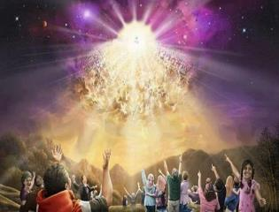
Titus 2:13
“Looking for the blessed hope and the appearing of the glory of our great God and Savior, Christ Jesus.”

Slide 90
Marvin J. Rosenthal, The Pre-Wrath Rapture of the Church: A New Understanding of the Tribulation, and the Second Coming (Nashville, TN: Thomas Nelson, 1990), 112.

Slide 91
Robert Lightner
Last Days Handbook: A Complete Guide to the End Times, Including the Meaning of the Year 2000 in Bible Prophecy, rev. ed. (Nashville: Thomas Nelson, 1997), 95.
“The prewrath Rapture view is different from the normal pretribulational view in that it does not consistently distinguish between God's program with Israel and His program with the church. The way it differs is that it has the church in Israel's seventieth week and does not hold to the doctrine of imminency.”

Slide 92
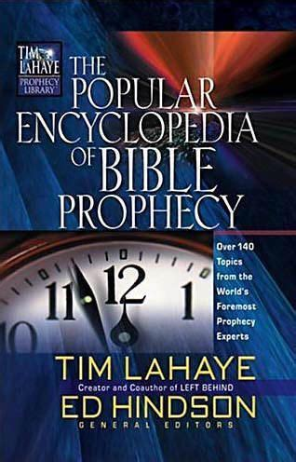
Tony Kessinger
“The doctrine of imminence holds that Christ can come to rapture His church at any moment. Believers in the early church, including the apostle Paul, believed that Christ could come in their lifetime (1 Thessalonians 1:10; 4:13-15; Titus 2:13). The church sees this doctrine as an incentive for ministry and godly living. Does this mean that Christ's return for His church will be at any moment, without any sign, and with no yet-to-be-fulfilled prophesied event to precede it?...Pre-wrath rapturists argue. . .
Tony Kessinger, "Pre-Wrath Rapture," in The Popular Encyclopedia of Bible Prophecy: Over 140 Topics from the World's Foremost Prophecy Experts, ed. Tim LaHaye and Ed Hindson (Eugene, OR: Harvest, 2004), 293.

Slide 93
Tony Kessinger
. . . that Christ could come in any generation but that signs will herald the general time. Those signs include (1) the emergence of the antichrist, (2) wars and rumors of war, (3) famine, (4) pestilence, and (5) cosmic disturbance. Pre-wrath rapturists emphasize Christians' expectancy of Christ's return rather than its imminency. This expectancy of Christ's return is the catalyst for holy living.”
Tony Kessinger, "Pre-Wrath Rapture," in The Popular Encyclopedia of Bible Prophecy: Over 140 Topics from the World's Foremost Prophecy Experts, ed. Tim LaHaye and Ed Hindson (Eugene, OR: Harvest, 2004), 293.

Slide 94
1 John 3:2-3
^{“2} Beloved, now we are children of God, and it has not appeared as yet what we will be. We know that when He appears, we will be like Him, because we will see Him just as He is. ³ And everyone who has this hope set on Him purifies himself, just as He is pure.”

Slide 95
J. Dwight Pentecost
Prophecy For Today, Page 20
“A short time ago, I took occasion to go through the New Testament to mark each reference to the coming of the Lord Jesus Christ and to observe the use made of that teaching about His coming. I was struck a new with the fact that almost without exception, when the coming of Christ is mentioned in the New Testament, it is followed by an exhortation to godliness and holy living.”

Slide 96
Matthew 24:46-50
^{“46} Blessed is that slave whom his master finds so doing when he comes. ⁴⁷ Truly I say to you that he will put him in charge of all his possessions. ⁴⁸ But if that evil slave says in his heart, ‘My master is not coming for a long time,’ ⁴⁹ and he begins to beat his fellow slaves, and he eats and drinks with those habitually drunk; ⁵⁰ then the master of that slave will come on a day that he does not expect, and at an hour that he does not know.”

Slide 97
Gerald B. Stanton
“Rosenthal‘s last chapter incorporates a final summary of his various positions, and also a final...attack against pre-tribulationalism and some of its leaders. The chapter sets forth the ‘pre-wrath rapture’ view as a ‘catalyst for holy living,’ without recognizing that much of that catalyst is lost if forty-two months of ‘sorrows’ and another twenty-one months of battle and martyrdom from the beast must come first.”
Gerald B. Stanton, Kept From the Hour: Biblical Evidence for the Pretribulational Return of Christ (Grand Rapids: Zondervan, 1956; reprint, Miami Springs, FL: Schoettle, 1991), 399.

Slide 98
II. Pre-Wrath Rapture Theory Problems
Places the Church in Daniel’s 70th Week
Fails to acknowledge the missing Church (Rev. 4‒22)
Confines God’s wrath to only a portion of the Tribulation's second half
Denies the Rapture’s imminency
Fails to consistently explain how the rapture is a comfort to the believer (John 14:1; 1 Thess. 4:18; Titus 2:13)
Misinterprets the restrainer (2 Thess. 2:6-7) as Michael the Archangel rather than the Holy Spirit

Slide 99
John 14:1–4
¹ “Do not let your heart be troubled; believe in God, believe also in Me. ² “In My Father’s house are many dwelling places; if it were not so, I would have told you; for I go to prepare a place for you. ³ “If I go and prepare a place for you, I will come again and receive you to Myself, that where I am, there you may be also. ⁴ “And you know the way where I am going.”

Slide 100
1 Thessalonians 4:16-18
¹⁶ For the Lord Himself will descend from heaven with a shout, with the voice of the archangel and with the trumpet of God, and the dead in Christ will rise first. ¹⁷ Then we who are alive and remain will be caught up [harpazō] together with them in the clouds to meet the Lord in the air, and so we shall always be with the Lord. ¹⁸ Therefore comfort one another with these words."

Slide 101
Titus 2:13
“Looking for the blessed hope and the appearing of the glory of our great God and Savior, Christ Jesus.”

Slide 103
Marvin J. Rosenthal, The Pre-Wrath Rapture of the Church: A New Understanding of the Tribulation, and the Second Coming (Nashville, TN: Thomas Nelson, 1990), 112.

Slide 104
1st Six Seals (Revelation 6)
SEAL 1 – 6:1-2 – Advent of antichrist
SEAL 2 – 6:3-4 – War
SEAL 3 – 6:5-6 – Famine
SEAL 4 – 6:7-8 – Death
SEAL 5 – 6:9-11 – Martyrdoms
SEAL 6 – 6:12-17 – Cosmic disturbances

Slide 105
II. Pre-Wrath Rapture Theory Problems
Places the Church in Daniel’s 70th Week
Fails to acknowledge the missing Church (Rev. 4‒22)
Confines God’s wrath to only a portion of the Tribulation's second half
Denies the Rapture’s imminency
Fails to consistently explain how the rapture is a comfort to the believer (John 14:1; 1 Thess. 4:18; Titus 2:13)
Misinterprets the restrainer (2 Thess. 2:6-7) as Michael the Archangel rather than the Holy Spirit

Slide 106
2 Thessalonians 2:6-7
⁶And you know what restrains [katechon; neuter] him now, so that in his time he will be revealed. ⁷For the mystery of lawlessness is already at work; only he who now restrains [katechōn; masculine] will do so until he is taken out of the way.

Slide 107
Marvin Rosenthal
“…of paramount importance is the identification of the one who restraints or hinders the Antichrist until ‘he [the restrainer] be taken out of the way.’ The restrainer is neither the Holy Spirit nor human government. Evidence is strained to support either of those contentions. There is, however, substantial evidence to identify the restrainer. He who restraints until ‘he be taken out of the way’ is the Archangel Michael.”
Marvin J. Rosenthal, The Pre-Wrath Rapture of the Church: A New Understanding of the Tribulation, and the Second Coming (Nashville, TN: Thomas Nelson, 1990), 112.

Slide 108
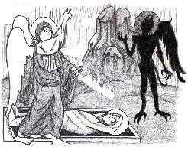
Jude 9
“But Michael the archangel, when he disputed with the devil and argued about the body of Moses, did not dare pronounce against him a railing judgment, but said, ‘The Lord rebuke you!’”

Slide 109
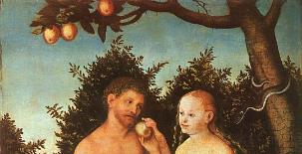
2 Thessalonians 2:9
“that is, the one whose coming is in accord with the activity of Satan, with all power and signs and false wonders.”

Slide 110
Daniel 12:1
“Now at that time Michael, the great prince who stands guard over the sons of your people [Israel], will arise. And there will be a time of distress such as never occurred since there was a nation until that time; and at that time your people, everyone who is found written in the book, will be rescued.”

Slide 111
Tony Kessinger
“The pre-wrath view holds to the rather inventive idea that Michael the archangel is the restrainer. This concept fails to take into consideration Michael's special protective ministry toward Israel.”
Tony Kessinger, "Pre-Wrath Rapture," in The Popular Encyclopedia of Bible Prophecy: Over 140 Topics from the World's Foremost Prophecy Experts, ed. Tim LaHaye and Ed Hindson (Eugene, OR: Harvest, 2004), 294.

Slide 112
Daniel 12:1
“Now at that time Michael, the great prince who stands guard over the sons of your people [Israel], will arise. And there will be a time of distress such as never occurred since there was a nation until that time; and at that time your people, everyone who is found written in the book, will be rescued.”

Slide 113
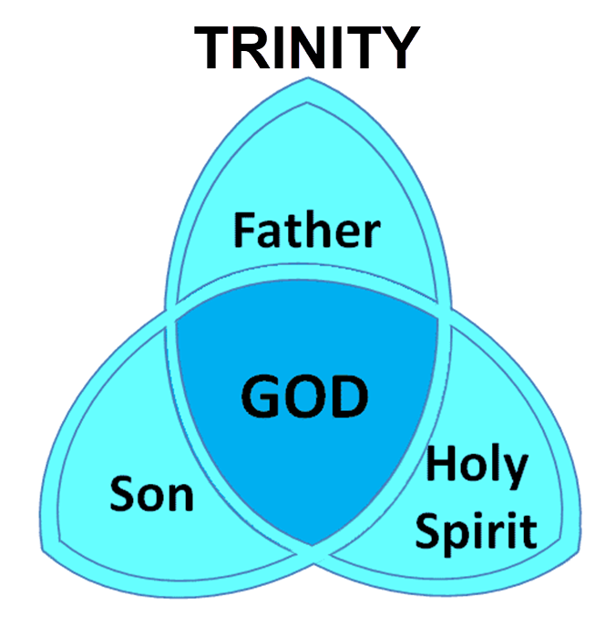

Slide 114
2 Reasons Why the Restrainer is the Holy Spirit (2 Thessalonians 2:6-7)
The Holy Spirit is omnipotent
The Holy Spirit view handles well the switch in gender from the neuter (vs. 6) to the masculine (vs. 7)

Slide 115
2 Thessalonians 2:9
“that is, the one whose coming is in accord with the activity of Satan, with all power and signs and false wonders.”

Slide 116
2 Thessalonians 2:6-7
⁶And you know what restrains [katechon; neuter] him now, so that in his time he will be revealed. ⁷For the mystery of lawlessness is already at work; only he who now restrains [katechōn; masculine] will do so until he is taken out of the way.

Slide 117
Pre-Wrath Rapturism
Description of the view
Six problems with the view considering prior Pre-Tribulational Arguments
Additional problems with the view

Slide 118
III. Additional Problems with Pre-Wrath Rapturism
It imposes an artificial construct on Daniel’s 70th Week
Great Tribulation (unequaled distress) before God’s wrath?
It places the Rapture in Revelation 7:9-17
It places the Rapture in Matthew 24:31, 40-41

Slide 119
III. Additional Problems with Pre-Wrath Rapturism
It imposes an artificial construct on Daniel’s 70th Week
Great Tribulation (unequaled distress) before God’s wrath?
It places the Rapture in Revelation 7:9-17
It places the Rapture in Matthew 24:31, 40-41

Slide 120
Daniel 9:27
“And he will make a firm covenant with the many for one week, but in the middle of the week he will put a stop to sacrifice and grain offering; and on the wing of abominations will come one who makes desolate, even until a complete destruction, one that is decreed, is poured out on the one who makes desolate.”

Slide 122
PROPHETIC SYNONYMNS
Division of the Tribulation into two 3½ year periods
42 months - Rev. 11:2; 13:5
1260 days – Rev. 11:3; 12:6
Time, times, and a half a time – Dan. 7:25; 12:7; Rev. 12:14

Slide 123
Matthew 24:15-16, 20
“¹⁵ Therefore when you see the abomination of desolation which was spoken of through Daniel the prophet, standing in the holy place (let the reader understand) ¹⁶ then those who are in Judea must flee to the mountains…²⁰ But pray that your flight will not be in the winter, or on a Sabbath.”

Slide 124
Marvin J. Rosenthal, The Pre-Wrath Rapture of the Church: A New Understanding of the Tribulation, and the Second Coming (Nashville, TN: Thomas Nelson, 1990), 112.

Slide 125
Three Parts?
“…the Scriptures never divide the Tribulation period into thirds. Daniel’s prophecy divides the seventieth week in two (Dan 9:27); half of the Tribulation is described as numbering 1260 days (Rev 11:3; 12:6). In fact, since Revelation 12:14 explains that God will protect fleeing Jews for ‘a time, and times, and half a time’ (1260 days); and since the beginning of this period is the beginning of the last three and one-half years, the Great Tribulation (Matt 24:15-22) must last for 1260 days. The Bible never divides the 1260 days into two 630 days.”
Larry D. Pettegrew, "The Messiah's Lecture on the Future of Israel," in Forsaking Israel: How It Happened and Why It Matters, ed. Larry D. Petegrew (The Woodlands, TX: Kress Biblical Resources, 2020), 340..

Slide 126
III. Additional Problems with Pre-Wrath Rapturism
It imposes an artificial construct on Daniel’s 70th Week
Great Tribulation (unequaled distress) before God’s wrath?
It places the Rapture in Revelation 7:9-17
It places the Rapture in Matthew 24:31, 40-41

Slide 127
Marvin J. Rosenthal, The Pre-Wrath Rapture of the Church: A New Understanding of the Tribulation, and the Second Coming (Nashville, TN: Thomas Nelson, 1990), 112.

Slide 128
Matthew 24:21
“For then there will be a great tribulation, such as has not occurred since the beginning of the world until now, nor ever will.”

Slide 129
Marvin J. Rosenthal, The Pre-Wrath Rapture of the Church: A New Understanding of the Tribulation, and the Second Coming (Nashville, TN: Thomas Nelson, 1990), 112.

Slide 130
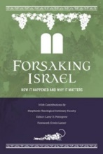
Unequaled Distress?
Larry D. Pettegrew, "The Messiah's Lecture on the Future of Israel," in Forsaking Israel: How It Happened and Why It Matters, ed. Larry D. Petegrew (The Woodlands, TX: Kress Biblical Resources, 2020), 341.
“A…flaw in the prewrath interpretation of Matthew 24:22 is its logical failure. The reason that the Great Tribulation is shortened, according to this verse, is that if it were not, no flesh would be saved. The point of the Scripture is that when the Great Tribulation is over, something better comes on the scene. In the prewrath scheme, however, something more horrible occurs after the Great Tribulation—the Day of the Lord. If no flesh would have survived if the Great Tribulation were allowed to continue on twenty-one months, surely no flesh would survive if the Great Tribulation were to be cut short and followed by twenty-one months of a more horrible Day of the Lord.…

Slide 131
Unequaled Distress?
Larry D. Pettegrew, "The Messiah's Lecture on the Future of Israel," in Forsaking Israel: How It Happened and Why It Matters, ed. Larry D. Petegrew (The Woodlands, TX: Kress Biblical Resources, 2020), 341.
…Moreover, Matthew 24:21 says that the Great Tribulation will be the worst time ever. So, how can it be replaced by the Day of the Lord which is more horrible? Wouldn’t that be the worst time ever? In fact, the Great Tribulation (Matt 24:21) and the Day of the Lord (Dan 12:1; Jer 30:7) are both said to be the worst time ever, so they must be the same time period or at least overlap.”

Slide 132
III. Additional Problems with Pre-Wrath Rapturism
It imposes an artificial construct on Daniel’s 70th Week
Great Tribulation (unequaled distress) before God’s wrath?
It places the Rapture in Revelation 7:9-17
It places the Rapture in Matthew 24:31, 40-41

Slide 134
Revelation 7:9, 13-14
“⁹ After these things I looked, and behold, a great multitude which no one could count, from every nation and all the tribes, peoples, and languages, standing before the throne and before the Lamb, clothed in white robes, and palm branches were in their hands.…¹³ Then one of the elders responded, saying to me, ‘These who are clothed in the white robes, who are they, and where have they come from?’ ¹⁴ I said to him, ‘My lord, you know.’ And he said to me, ‘These are the ones who come out of the great tribulation [thlípsis], and they have washed their robes and made them white in the blood of the Lamb.’”

Slide 135
Marvin Rosenthal
“That great multitude represents the true Church which goes into the Seventieth Week of Daniel. They are raptured and at the end of the Great Tribulation but before the Day of the Lord begins. They are raptured before God’s wrath is poured out but are not exempt from the ultimate rebellion of unregenerate men... Therefore, in chapter 7 the Church is raptured. But immediately prior to the rapture of the Church the 144,000 Jews are sealed...The 144,000 must be sealed for protection to go through the Day of the Lord before the Church can be caught up to the throne in heaven.”
Marvin J. Rosenthal, The Pre-Wrath Rapture of the Church: A New Understanding of the Tribulation, and the Second Coming (Nashville, TN: Thomas Nelson, 1990), 185.

Slide 136
PRE-WRATH RAPTURIST – ALAN KURSCHNER
MATTHEW 24 | PARALLELS | REVELATION 6-7
4-5 | The Antichrist / False Christs | 1st Seal (6:1-2)
6-7 | Wars | 2nd Seal (6:3-4)
7 | Famine | 3rd Seal (6:5-6)
9, 21-22 | Martyrdom / (Great Tribulation) | 4th Seal (6:7-8)
9, 21-22 | Result of Martyrdom / (Great Tribulation) | 5th Seal (6:9-11)
29 | Celestial Disturbances | 6th Seal (6:12-17)
30-31 | Raptured Saints | Interlude (7:9-17)
14, 30, 37-40 | Day of the Lord’s Wrath | 7th Seal (Trumpet, Bowls)
Alan Kurschner, The Antichrist Before the Day of the Lord: What Every Christian Needs to Know About the Return of Christ (Pompton Lakes, NI: Eschatos, 2013, 99.

Slide 137
Revelation 7:13-14
¹³ Then one of the elders responded, saying to me, ‘These who are clothed in the white robes, who are they, and where have they come from?’ ¹⁴ I said to him, ‘My lord, you know.’ And he said to me, ‘These are the ones who come out of the great tribulation [thlípsis], and they have washed their robes and made them white in the blood of the Lamb.’”

Slide 138
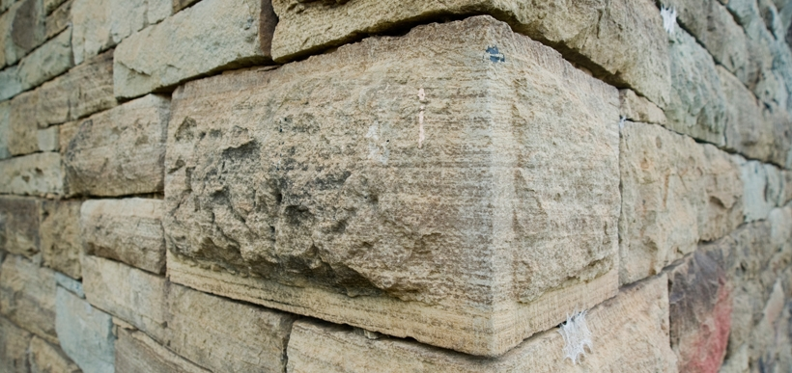
Ephesians 2:20
“having been built on the foundation of the apostles and prophets, Christ Jesus Himself being the corner stone.”

Slide 139
Revelation 7:13-14
¹³ . . .‘These who are clothed in the white robes, who are they, and where have they come (erchomai) from?’ ¹⁴ I said to him, ‘My lord, you know.’ And he said to me, ‘These are the ones who come (erchomai) out of the great tribulation [thlípsis], and they have washed their robes and made them white in the blood of the Lamb.’”

Slide 140
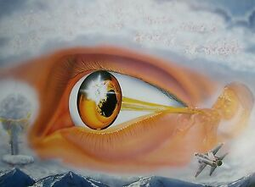
1 Corinthians 15:52
“in a moment [atomos], in the twinkling of an eye, at the last trumpet; for the trumpet will sound, and the dead will be raised imperishable, and we will be changed.”

Slide 141
Rev. 7:14 Robert L. Thomas, Revelation 1–7: An Exegetical Commentary, ed. Kenneth Barker (Chicago: Moody, 1992), 497, n. 119.
"A…possible understanding that it is a departure after the Great Tribulation is completed (Marvin Rosenthal, The Pre-Wrath Rapture of the Church [Nashville: Thomas Nelson, 1990], p. 185) can be dismissed because it neglects the ongoing nature of the departure indicated by the present participle ἐρχόμενοι and rests on an unwarranted distinction between the Great Tribulation and the day of the God’s wrath."

Slide 142
Gerald B. Stanton
“However, the innumerable multitude is not like the Church, which goes to heaven as a group at the rapture. Rather, they are martyrs who one at a time lay down their lives throughout the seven-year period. The Greek present tense in Revelation 7:14 stresses that they ‘continually come’ out of great Tribulation, and obviously do not go to heaven as a single group. It is likewise strange, if they do represent the Church, that John could not recognize them, for John was an apostle of Christ, a member of the early Church, and part of its essential foundation. Also, the Church is composed of all believers since Pentecost, and cannot be limited solely to Tribulation martyrs.”
Kept from the Hour: Biblical Evidence for the Pretribulational Return of Christ (Grand Rapids: Zondervan, 1956; reprint, Miami Springs, FL: Schoettle, 1991), 390.

Slide 143
Distinctions Between 144,000 & Multitude
144,000 | MULTITUDE
Revelation 7:1-8 | Revelation 7:9-17
Numbered | Innumerable
Jews | All nations
Sealed | Slain
Sealed before the Tribulation | Converted out of the Tribulation
Hitchcock and Ice, The Truth Behind Left Behind, 77

Slide 144
III. Additional Problems with Pre-Wrath Rapturism
It imposes an artificial construct on Daniel’s 70th Week
Great Tribulation (unequaled distress) before God’s wrath?
It places the Rapture in Revelation 7:9-17
It places the Rapture in Matthew 24:31, 40-41

Slide 145
Matthew 24:31
“And He will send forth His angels with a great trumpet and they will gather together [episynagō] His elect from the four winds, from one end of the sky to the other.”

Slide 146
PRE-WRATH RAPTURIST – ALAN KURSCHNER
MATTHEW 24 | PARALLELS | REVELATION 6-7
4-5 | The Antichrist / False Christs | 1st Seal (6:1-2)
6-7 | Wars | 2nd Seal (6:3-4)
7 | Famine | 3rd Seal (6:5-6)
9, 21-22 | Martyrdom / (Great Tribulation) | 4th Seal (6:7-8)
9, 21-22 | Result of Martyrdom / (Great Tribulation) | 5th Seal (6:9-11)
29 | Celestial Disturbances | 6th Seal (6:12-17)
30-31 | Raptured Saints | Interlude (7:9-17)
14, 30, 37-40 | Day of the Lord’s Wrath | 7th Seal (Trumpet, Bowls)
Alan Kurschner, The Antichrist Before the Day of the Lord: What Every Christian Needs to Know About the Return of Christ (Pompton Lakes, NI: Eschatos, 2013, 99.

Slide 147
1 Corinthians 15:50-51
“⁵⁰ Now I say this, brethren, that flesh and blood cannot inherit the kingdom of God; nor does the perishable inherit the imperishable. ⁵¹ Behold, I tell you a mystery; we will not all sleep, but we will all be changed.”

Slide 148
1 Thessalonians 4:16-18
^{“16} For the Lord Himself will descend from heaven with a shout, with the voice of the archangel and with the trumpet of God, and the dead in Christ will rise first. ¹⁷ Then we who are alive and remain will be caught up [harpazō] together with them in the clouds to meet the Lord in the air, and so we shall always be with the Lord. ¹⁸ Therefore comfort one another with these words."

Slide 149
Matthew 24:31
“And He will send forth His angels with a great trumpet and they will gather together [episynagō] His elect from the four winds, from one end of the sky to the other.”

Slide 150
Matthew 23:37-39
³⁷ “Jerusalem, Jerusalem, who kills the prophets and stones those who are sent to her! How often I wanted to gather [episynagō] your children together, the way a hen gathers [episynagō] her chicks under her wings, and you were unwilling. ³⁸ Behold, your house is being left to you desolate! ³⁹ For I say to you, from now on you will not see Me until you say, ‘Blessed is He who comes in the name of the Lord!’”

Slide 151
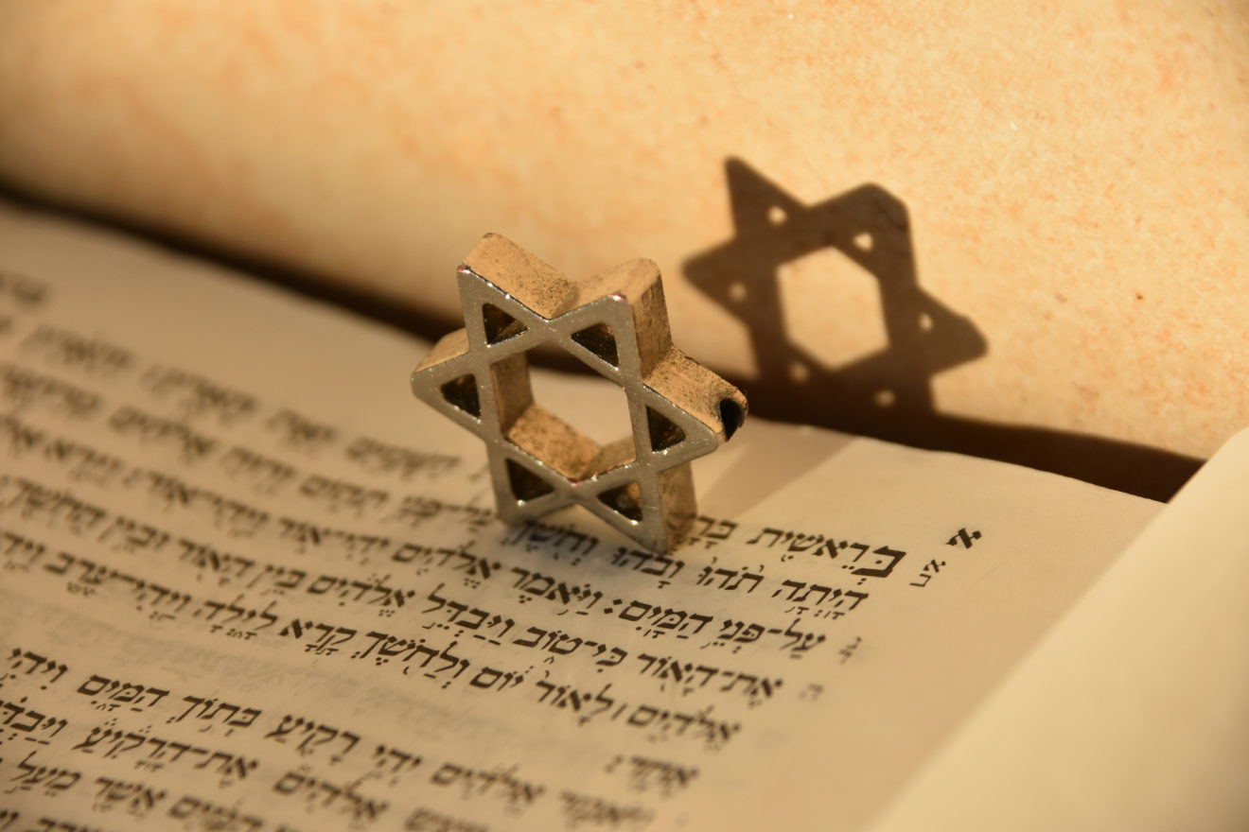
Matthew 24:15-16, 20
“¹⁵ Therefore when you see the abomination of desolation which was spoken of through Daniel the prophet, standing in the holy place (let the reader understand) ¹⁶ then those who are in Judea must flee to the mountains…²⁰ But pray that your flight will not be in the winter, or on a Sabbath.”

Slide 152
Isaiah 27:13
“It will come about also in that day that a great trumpet will be blown, and those who were perishing in the land of Assyria and who were scattered in the land of Egypt will come and worship the Lord in the holy mountain at Jerusalem.”

Slide 153
Conclusion

Slide 154
Pre-Wrath Rapturism
Description of the view
Problems with the view considering prior Pre-Tribulational Arguments
Additional problems with the view

